Slide 1
Team Project - OpenHome
CMPE 275 - Sec 01
Presented By
Project Group #13
1] Chintala Dheeraj Dharma 013760968
2] Manish Katturu 013825201
3] Sayali Patil 013530439
4] Surabhi Sinha 013704652

Slide 2
Introduction
OpenHome, a web application allowing hosts to post properties and guests to search and book properties along with additional features
MVC Architecture
Back End : Java Spring Boot
Aspect Oriented Programming
Dependency Injection
ORM
JPA
Hibernate
Front End : ReactJS
Database : MySql [ AWS RDS ]

Slide 3
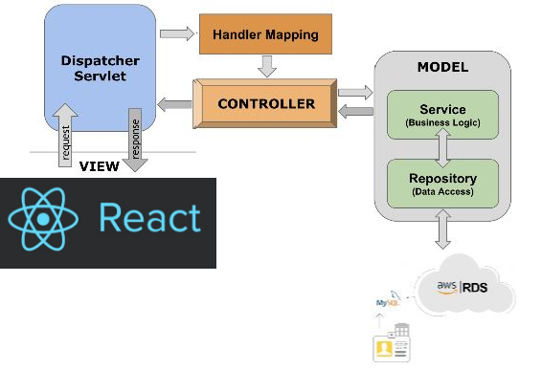
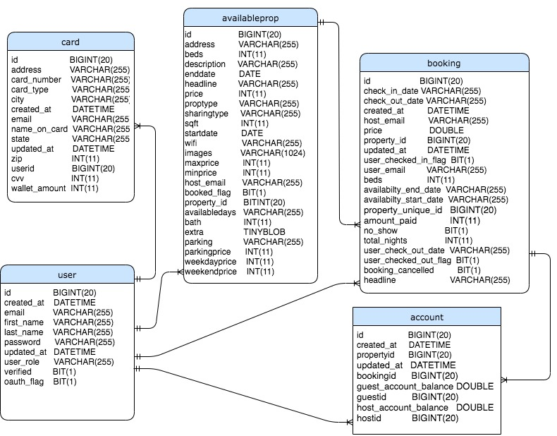
High-Level Design
Database Design

Slide 4
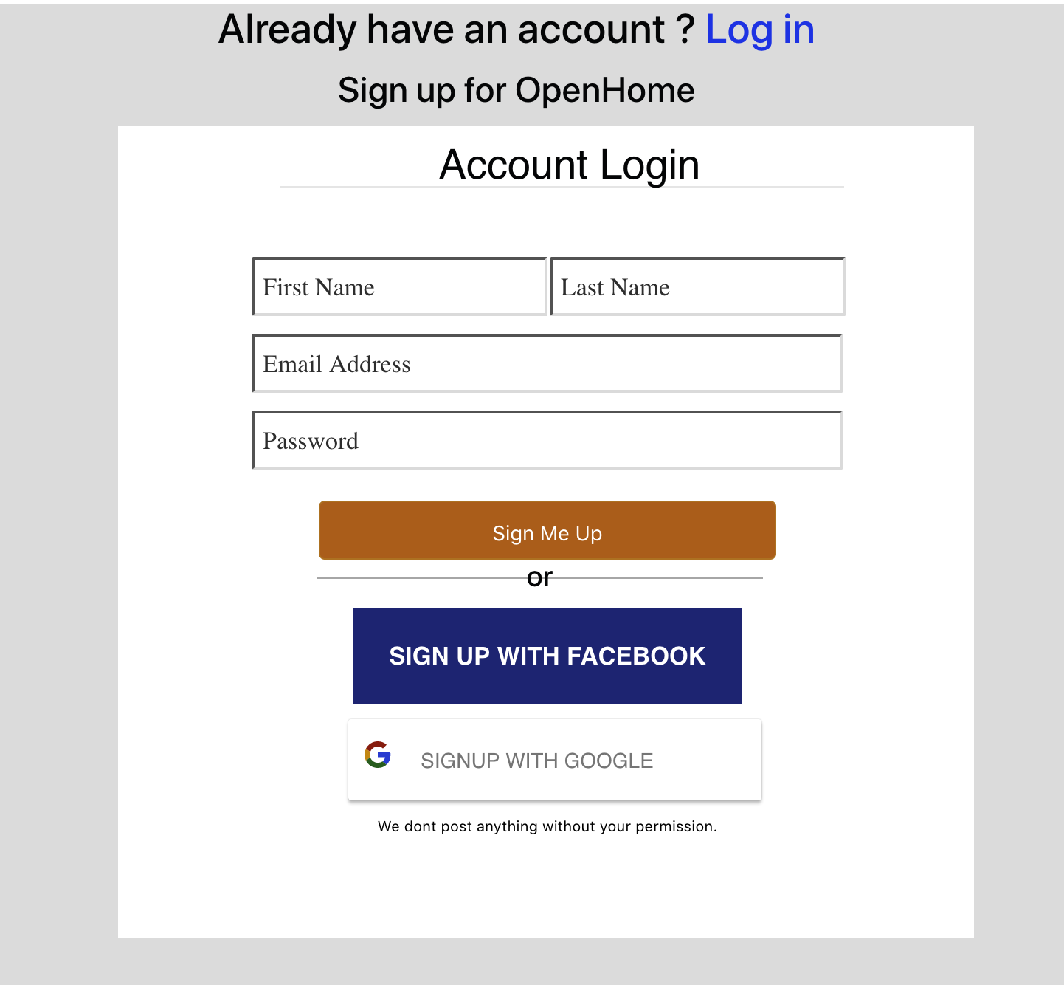
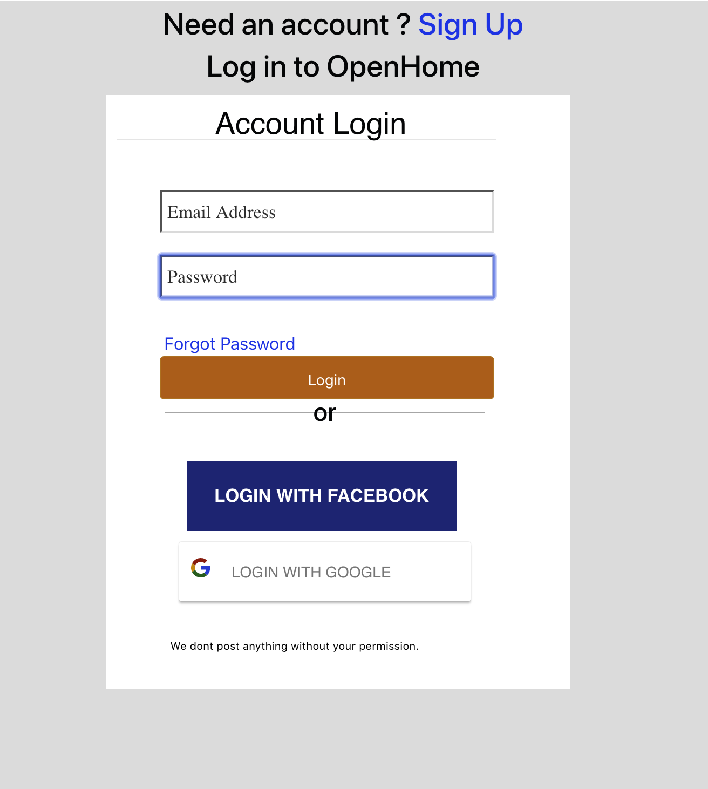
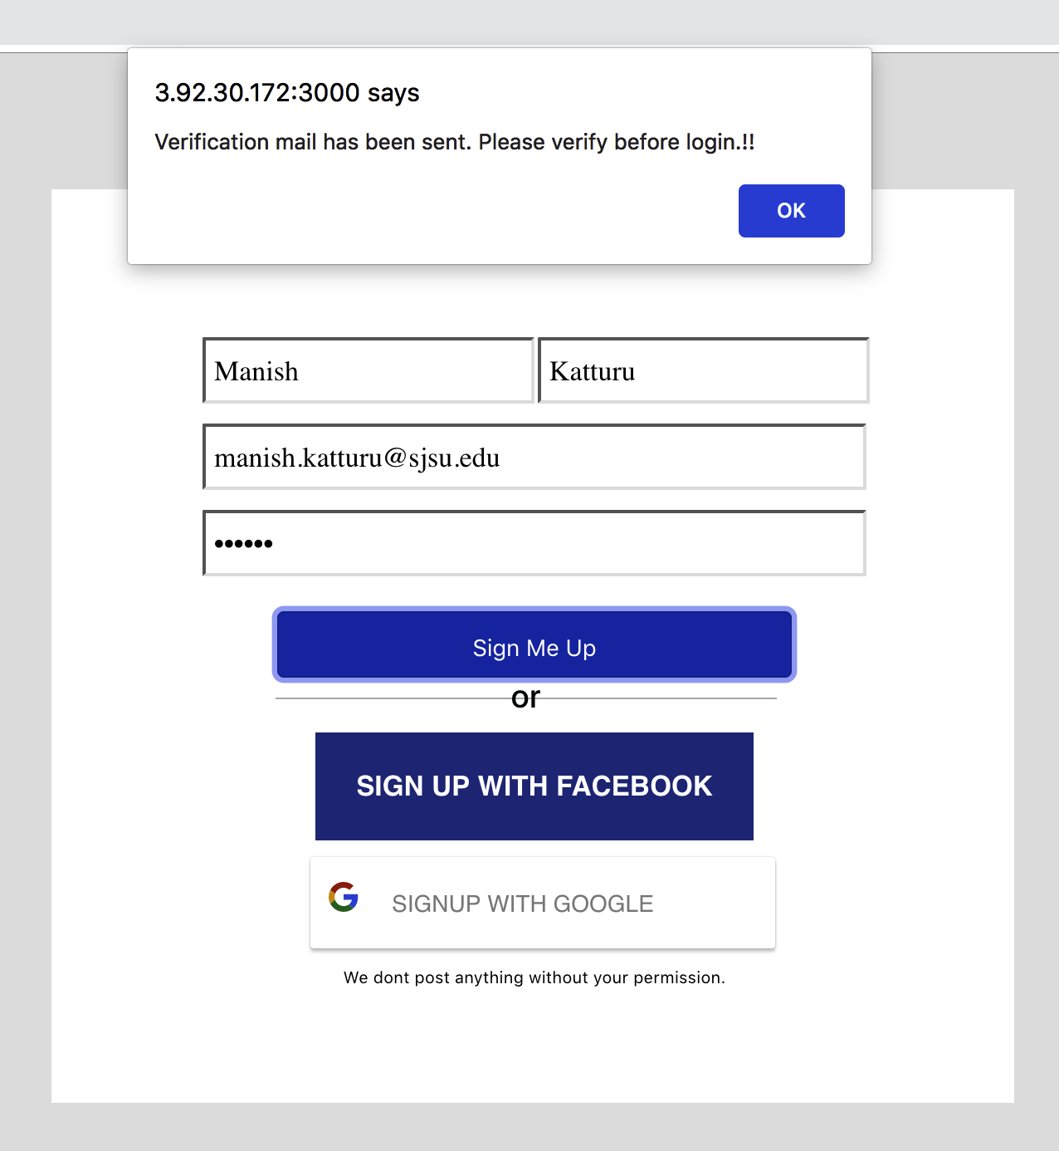
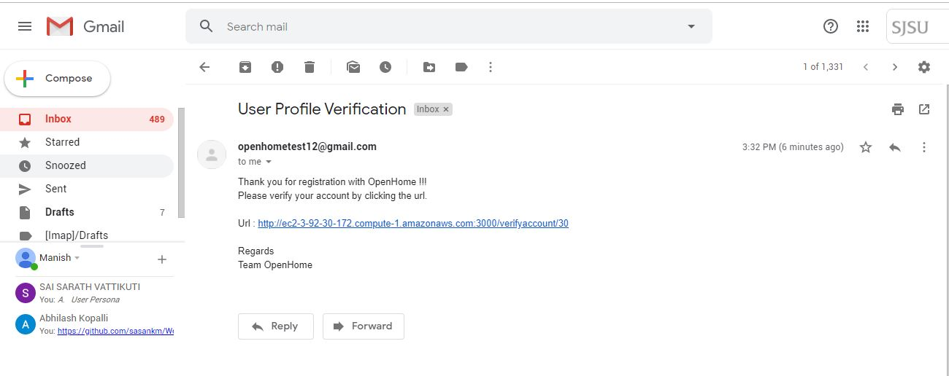
Feature : Signup/Login/Account Verification

Slide 5
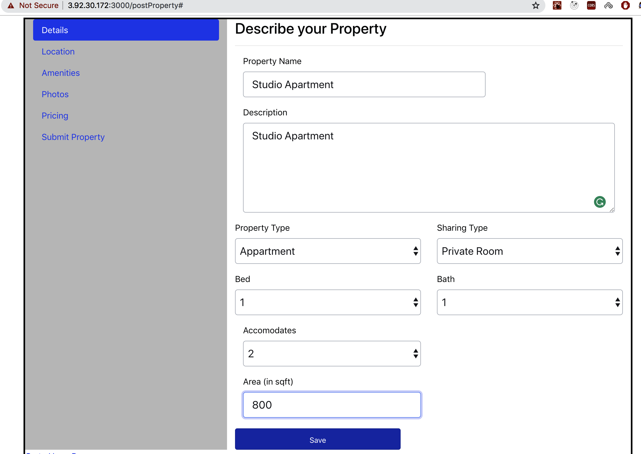
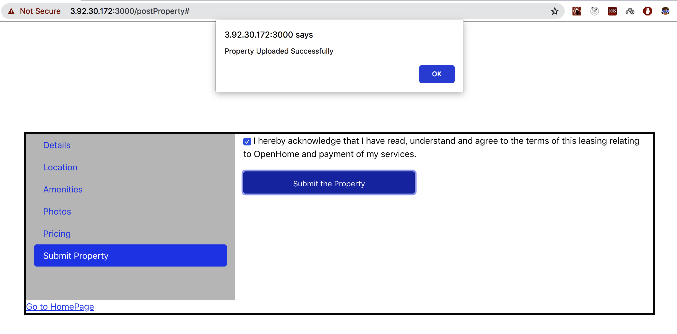
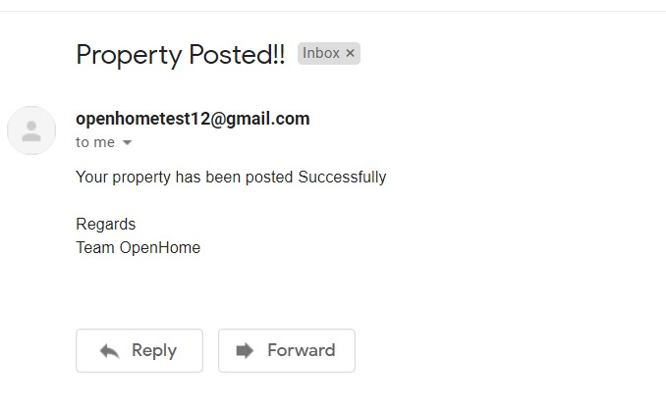
Feature : Host - Property Posting

Slide 6
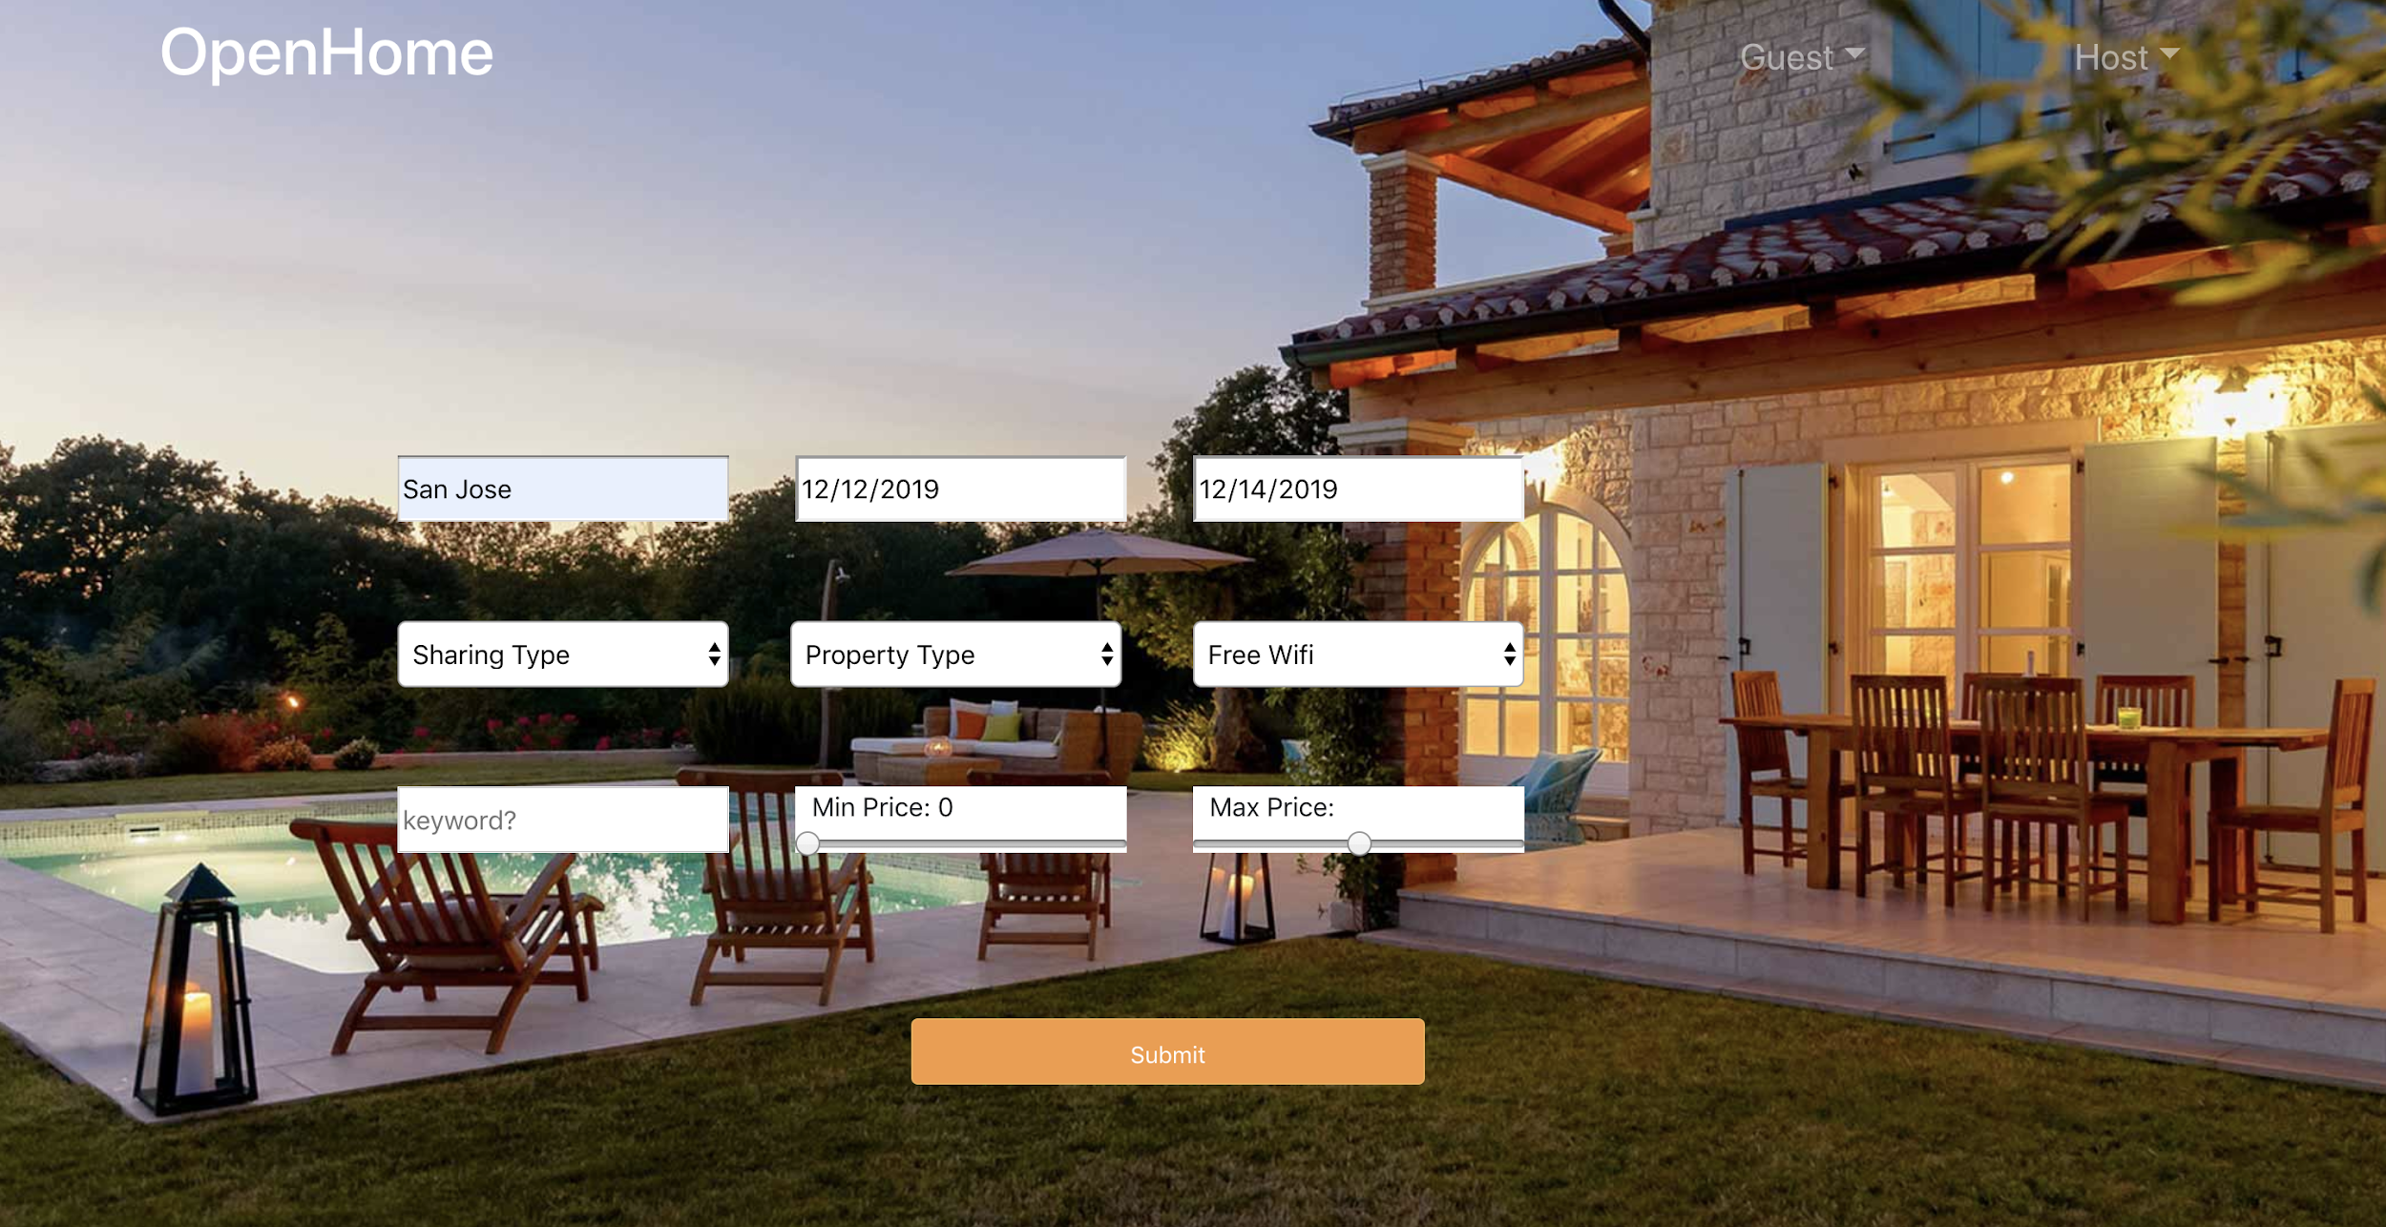
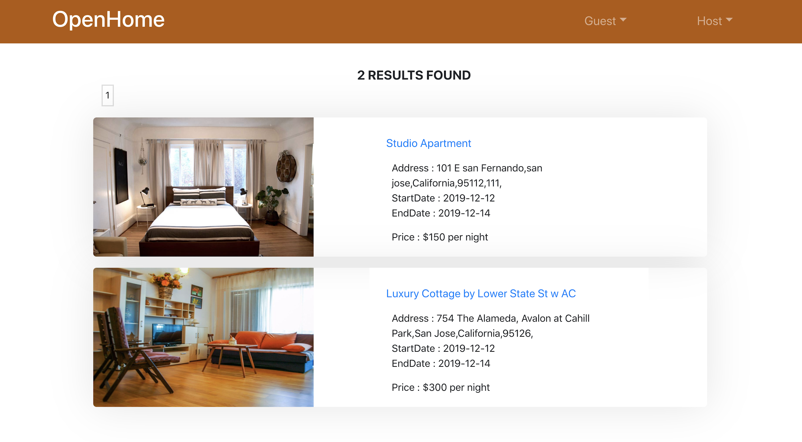
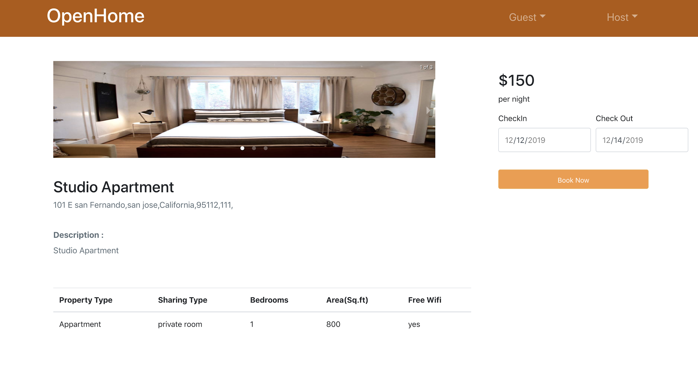
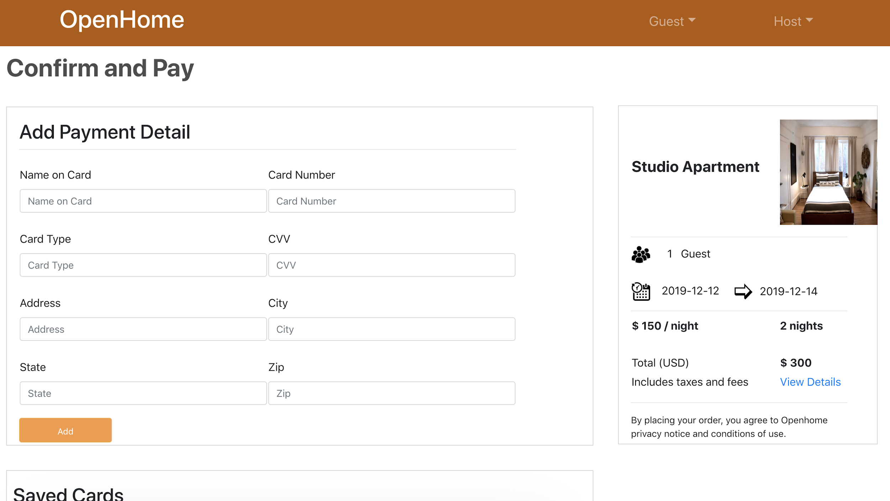
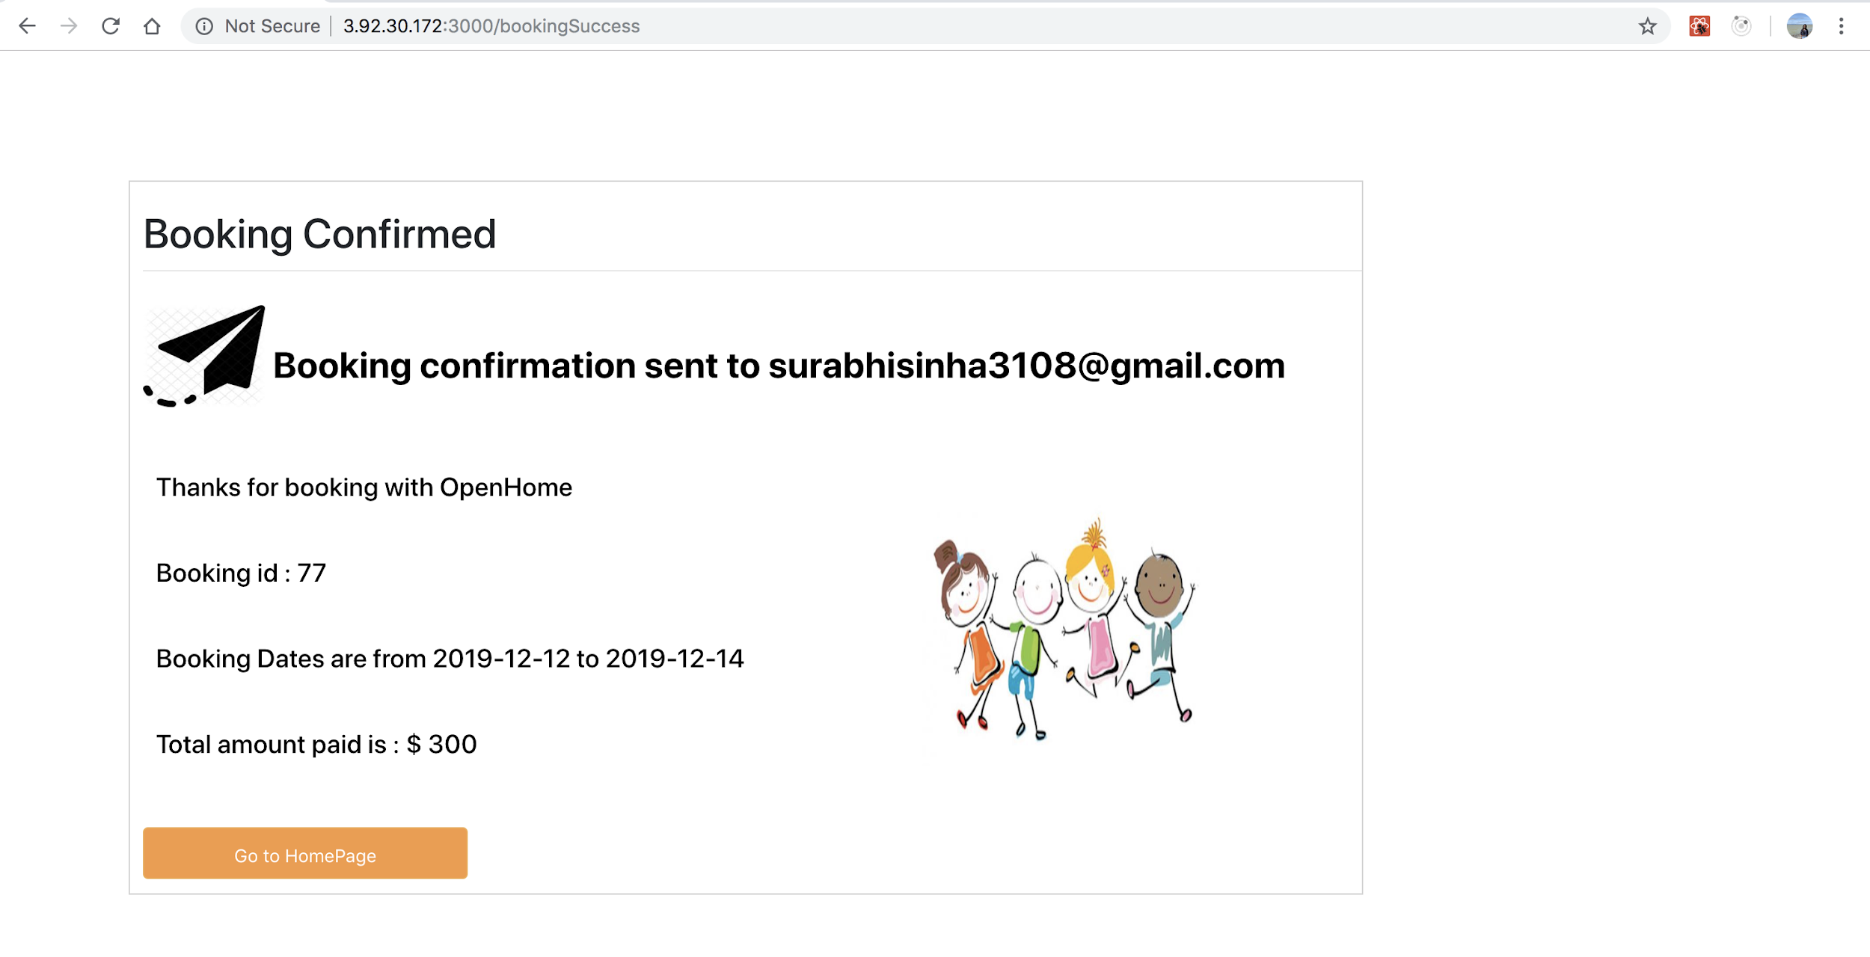
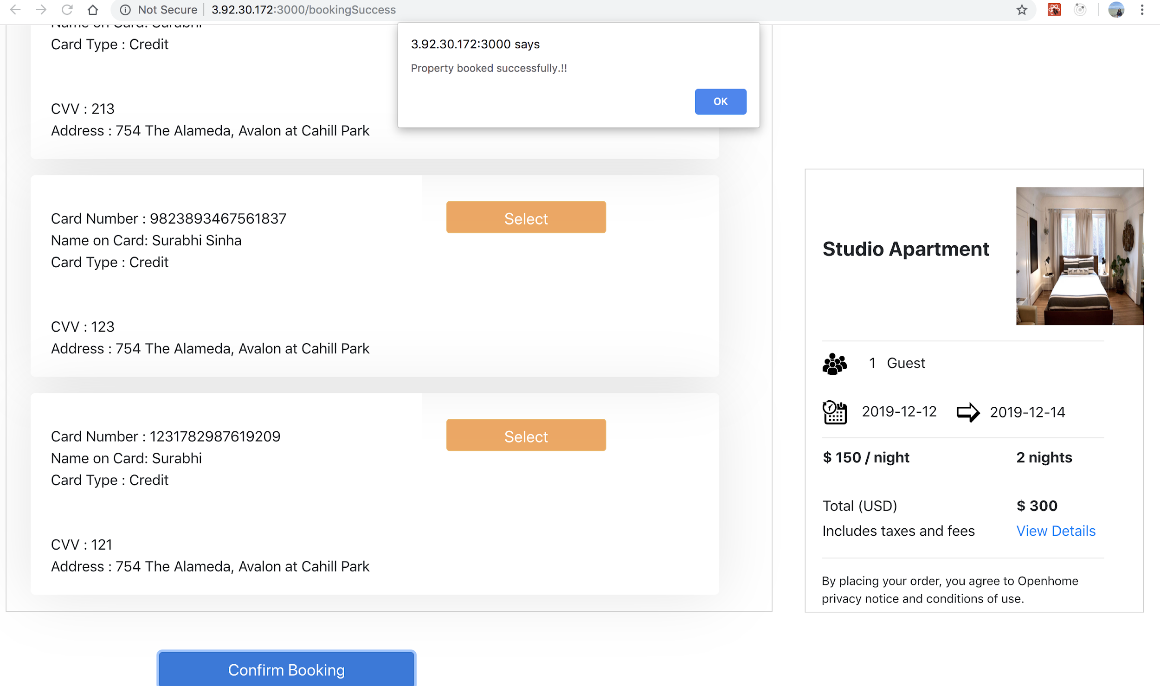
Guest Feature : Home page/Search/Booking

Slide 7
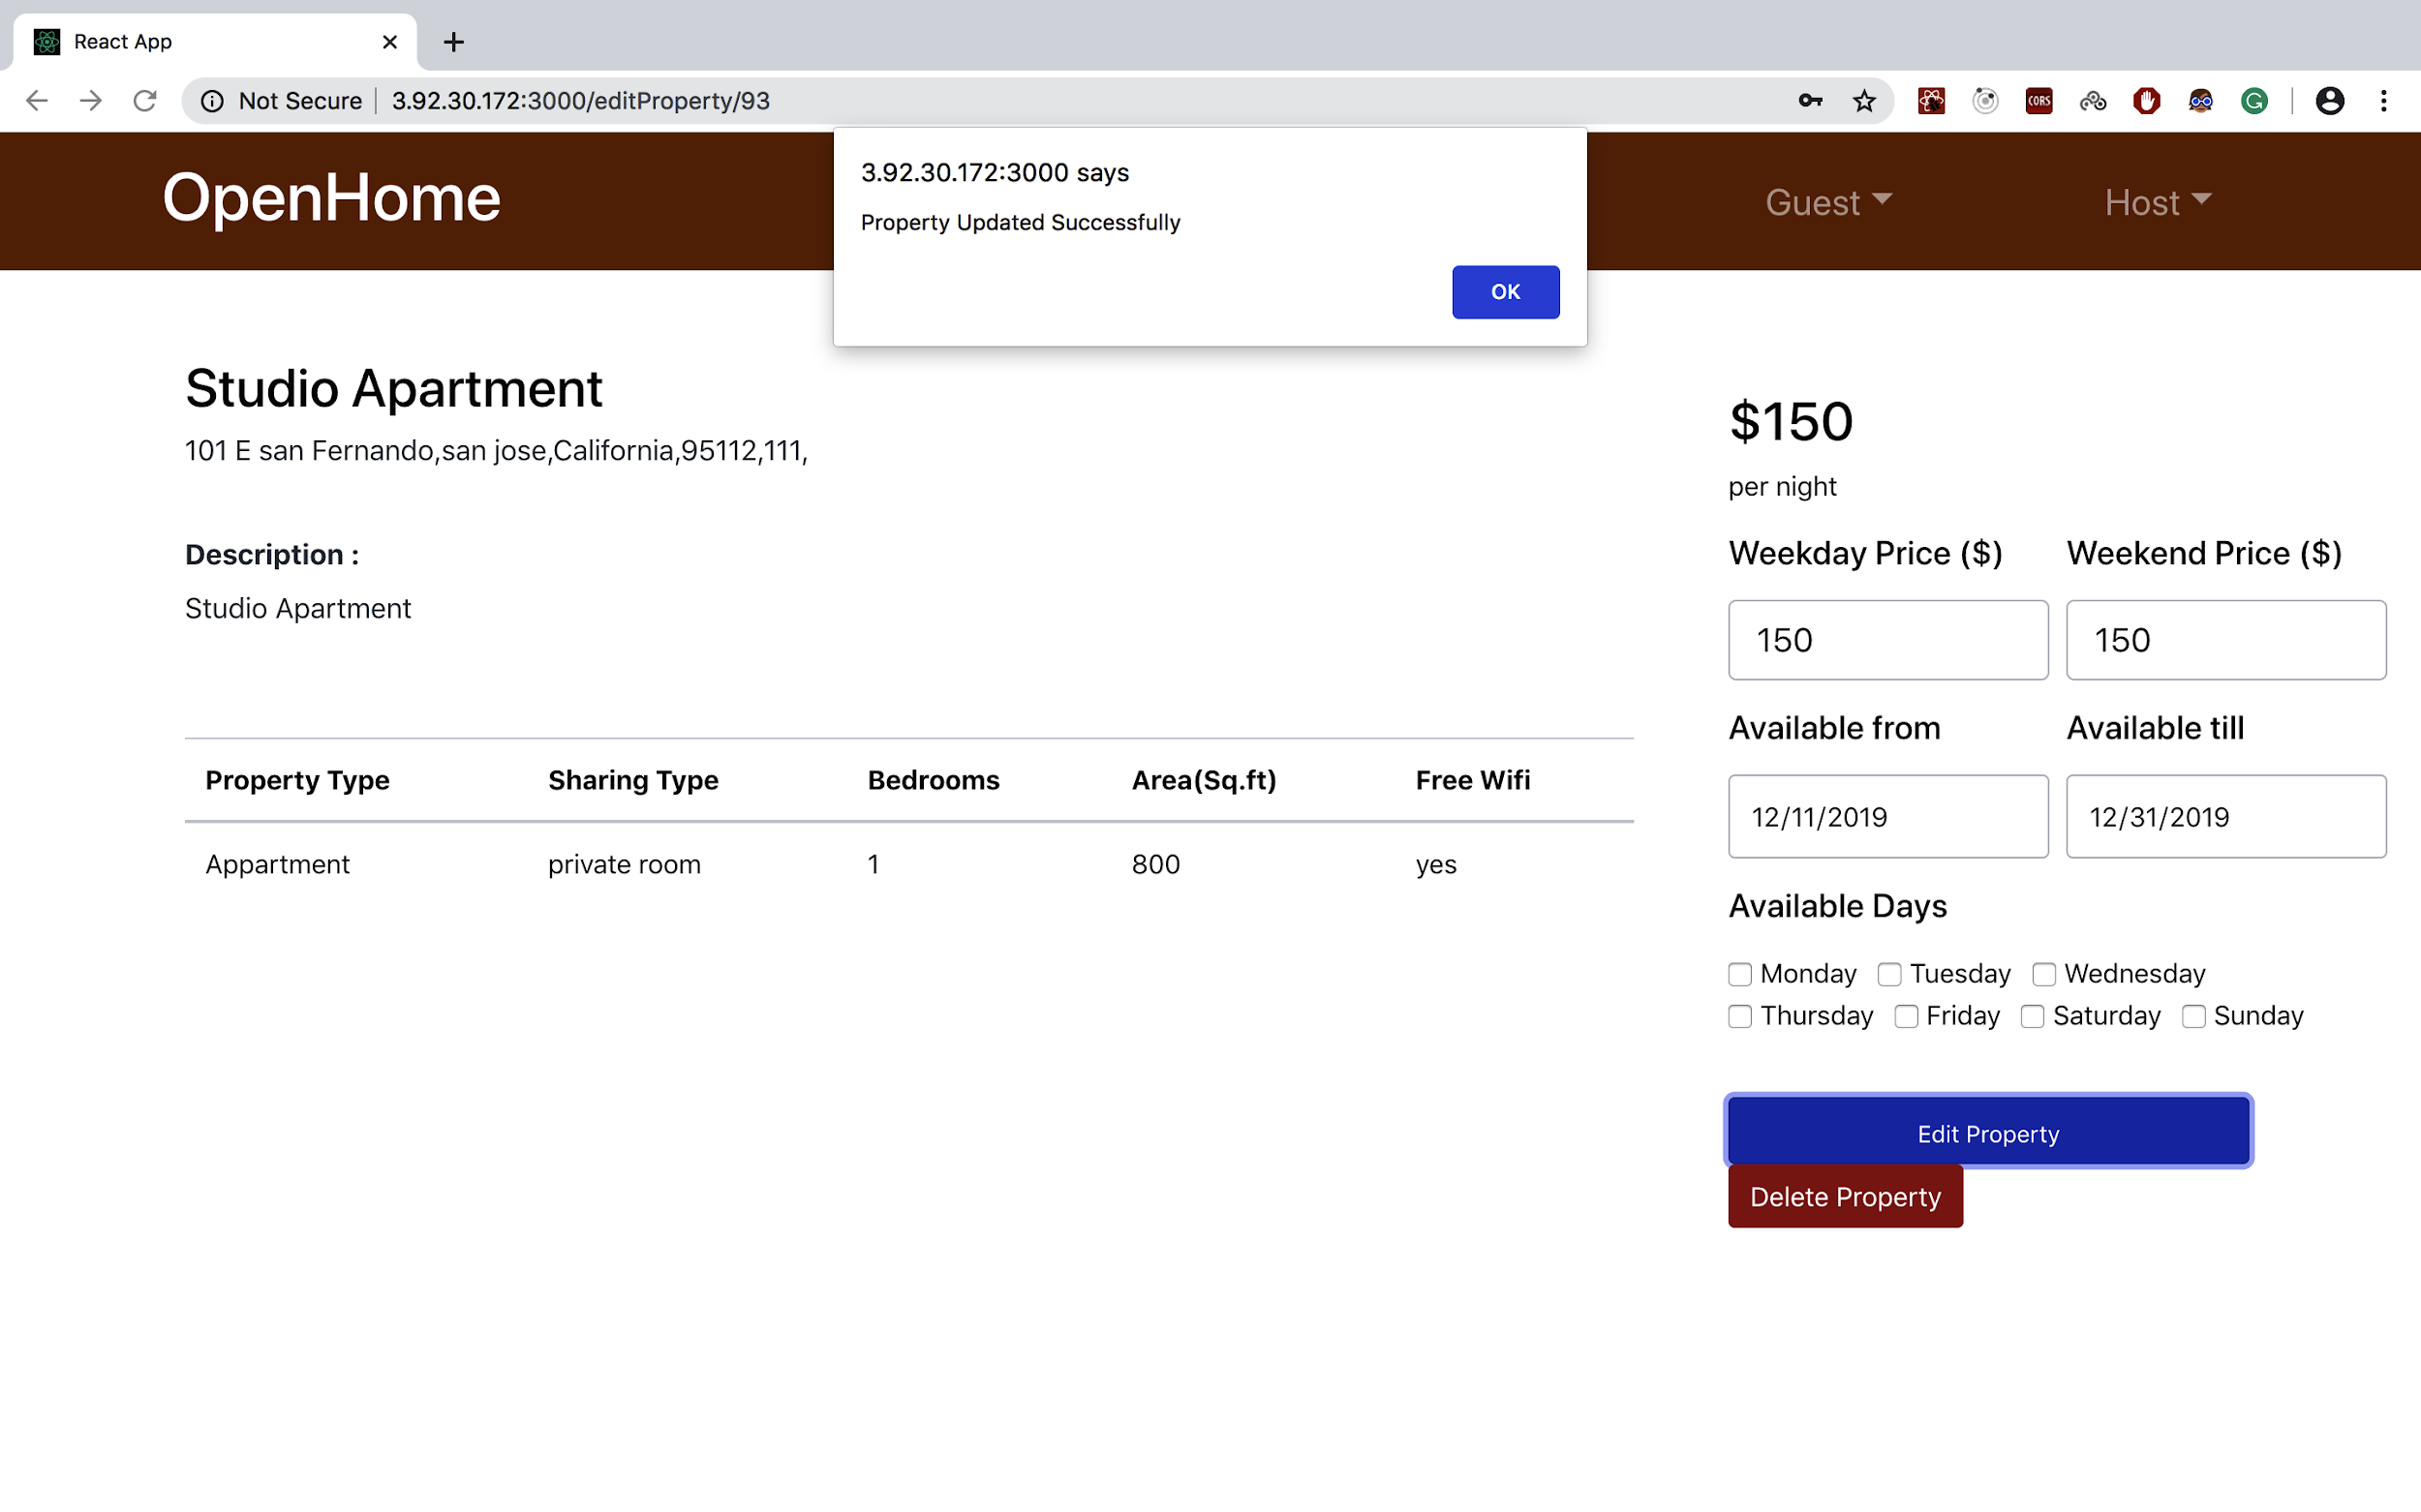
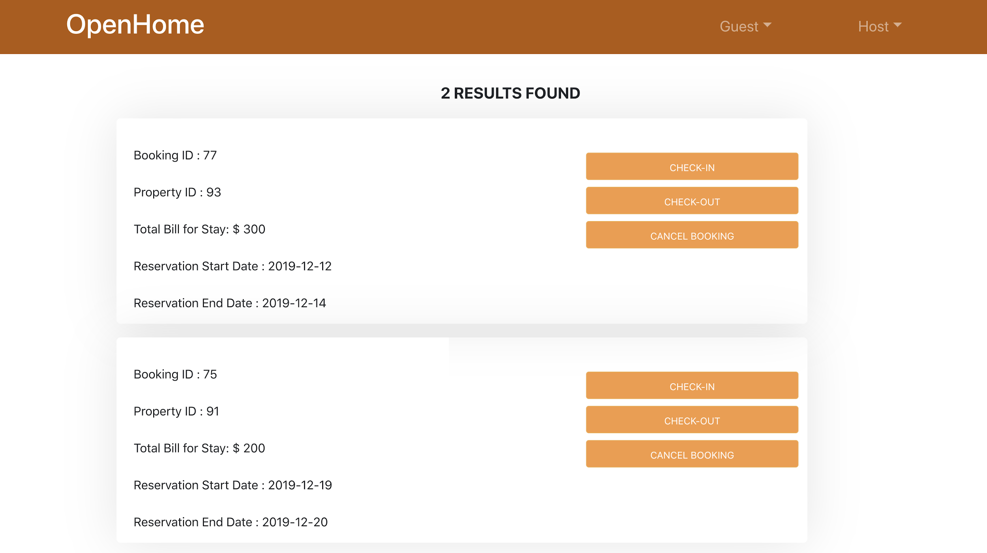

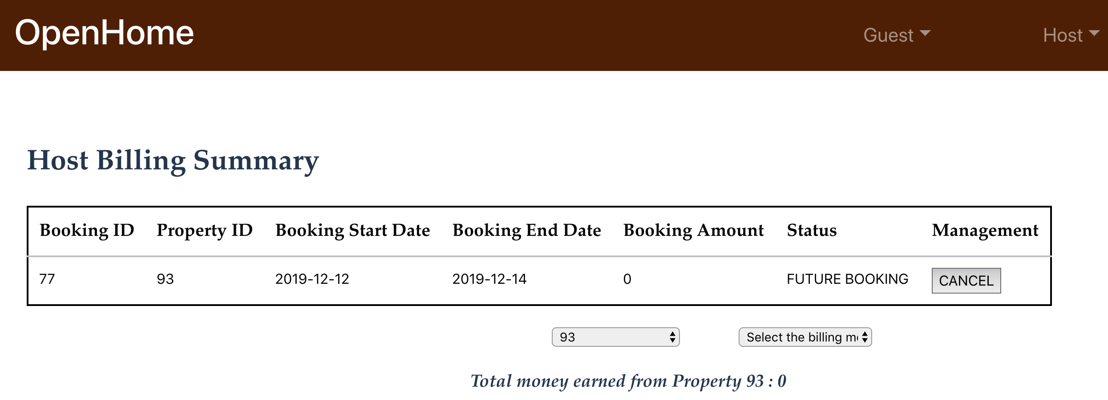
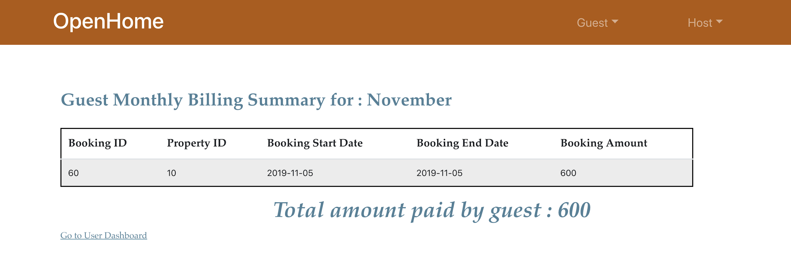
Feature : Host Dashboard
Feature :Guest Dashboard

